Slide 1
Prevention with Purpose: A Strategic Planning Guide for Preventing Drug Misuse Among College Students
Trainer first and last name
Trainer Location
Trainer Date
Drug Enforcement Administration
Notes:
(Insert your name and the date/location of the training on the slide.)
Welcome the participants. Introduce yourself and any other trainers.
Point out that the focus of this training is to provide an introduction to Prevention with Purpose: A Strategic Planning Guide for Preventing Drug Misuse Among College Students, a publication funded by the Drug Enforcement Administration published in January 2020.

Slide 2
Introductions
What is
your name?
What is your job?
How many years have you worked in prevention?
What field/ background do you come from?
Notes:
Ask participants to introduce themselves and answer the questions on the slide. If the group is too large for individual introductions, have participants find someone they don’t know and share their answers to each of these questions with their partner.
By hearing from participants, you will get an indication of how much knowledge and experience the group of participants has.

Slide 3
Why Drug Misuse Prevention on College Campuses?
Opportunity to prevent drug use that tends to start while in college
Ideal setting for prevention efforts
Many individuals committed to students’ health and well-being
WHY?
Notes:
Share with participants that before we delve into what the strategic planning guide contains, let’s step back and look at why it is essential that drug misuse prevention efforts exist on college campuses.
Review the points on the slide. Ask participants to share any other reasons why they believe that drug misuse prevention is important on college campuses. Take a few comments then move on to the next slide.
Arria, A., & Wagley, G. (2019). Addressing college drinking and drug use: A primer for trustees, administrators and alumni (pp. 1–34). Washington, DC: American Council of Trustees and Alumni.

Slide 4
Current Trends in Young Adult Drug Use (1 of 2)
Alcohol is most widely used drug on college campuses.
75% of students reported they used alcohol in past year
40.3% of college women reported being drunk in past month
35.5% of college men reported being drunk in past month
Notes:
Share with participants that pages 13 and 14 of the strategic planning guide include data on trends in drug use among college students.
Explain that three drugs are highlighted on this and the following slide but more are included in the guide.
Review the data on the slide. Ask participants if they are surprised by any of these numbers.
Centers for Disease Control and Prevention. (2019). Smoking & tobacco use. Retrieved from https://www.cdc.gov/ tobacco/basic_information/e-cigarettes/severe-lung-disease.html
20
Schulenberg, J. E., Johnston, L. D., O’Malley, P. M., Bachman, J. G., Miech, R. A. & Patrick, M. E. (2019). Monitoring the Future national survey results on drug use, 1975–2018: Volume II, College students and adults ages 19–60. Ann Arbor: Institute for Social Research, The University of Michigan.

Slide 5
Current Trends in Young Adult Drug Use (2 of 2)
Cannabis is second most used drug on college campuses.
25% of college students reported past 30-day use
6% reported daily use (20 or more times in one month)
2x Daily use is twice as high among college men
Vaping use continues to rise.
20% Past year use: vaping cannabis
25% Past year use: vaping nicotine
Notes:
Review the data on the slide. Ask participants if they are surprised by any of these numbers. Point out that with the rising numbers of vaping-related lung illnesses, vaping is ripe for prevention and education efforts.
Schulenberg, J. E., Johnston, L. D., O’Malley, P. M., Bachman, J. G., Miech, R. A. & Patrick, M. E. (2019). Monitoring the Future national survey results on drug use, 1975–2018: Volume II, College students and adults ages 19–60. Ann Arbor: Institute for Social Research, The University of Michigan.

Slide 6
So What Do We Do?
Become chess “Grandmasters” by implementing the Strategic Prevention Framework (SPF)
Notes:
Share the following analogy (adapted from https://www.workamajig.com/blog/5-analogies-about-resource-management):
A good chess player thinks about what moves her opponent might make during the next turn. A great chess player thinks a few moves ahead and devises a plan. A Grandmaster however, has more than just a strategy for the entire match; she has contingencies in place for when the tide shifts differently than she wanted it to.
A prevention professional needs to think like a Grandmaster. She needs to be not just a few moves ahead, but ready for almost anything. A Grandmaster has a plan for each piece, from pawn to king, and adjusts it as the game progresses. Likewise, in prevention you create a plan and adjust it as needed.
The difference is that while a Grandmaster has a definite start and end frame, prevention does not. There are new projects starting up regularly and no lack of complexity to the situation. There is no checkmate in prevention, only forging ahead as new situations present themselves on our campuses. So how do we put in place a process that allows us to respond quickly and efficiently? That is where the SPF comes in.

Slide 7
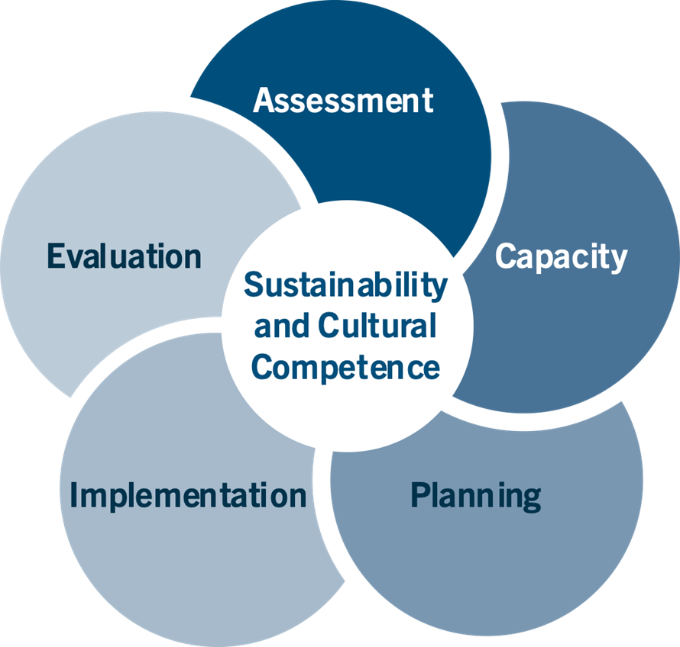
Strategic Prevention Framework
Notes:
Explain that the SPF answers the question, “How will we do drug misuse prevention effectively on college campuses?” It provides us with the tools to be the “Grandmaster of Prevention” on your campus.
Share that practitioners often feel an urgent need to implement immediate solutions to the pressing substance misuse problems facing their communities. But research and experience have shown that prevention must begin with an understanding of these complex behavioral health problems within their complex environmental contexts; only then can communities establish and implement effective plans to address substance misuse.
To facilitate this understanding, SAMHSA developed the Strategic Prevention Framework (SPF). The five steps and two guiding principles of the SPF offer prevention practitioners a comprehensive approach to understanding and addressing the substance misuse and related behavioral health problems. The five steps include: assessment, capacity building, planning, implementation, and evaluation. All of the steps are guided by two central principles—cultural competence and sustainability—which should be integrated into each step of the SPF.
Cultural competence describes the ability of an individual or organization to interact effectively with members of diverse population groups. At a college or university, this means understanding that specific student communities on your campus may have very different ways of thinking about and understanding a substance misuse issue. This must be taken in account when working on each step of the SPF.
Equally important is the concept of sustainability, or the process of building an adaptive and effective system that achieves and maintains desired long-term results. To break the cycle of “one-off” programs and campaigns on your campus, working on sustainability is essential during each step of the SPF.
The strategic planning guide walks higher education prevention professionals through how to use the SPF to plan and implement their prevention efforts.

Slide 8
Why Use the Strategic Prevention Framework? Because it…
Is data driven
Is dynamic and iterative
Relies on and encourages a team approach
Good decisions require data.
The SPF is a circular, rather than a linear, model.
Requires—and benefits from—participation from diverse community partners.
Notes:
Share that there are many advantages to using the SPF, including those listed on the slide.
Point out the following regarding the SPF’s defining characteristics that set it apart from other strategic planning processes:
It is data-driven. The SPF is designed to help practitioners gather and use data to guide all prevention decisions—from identifying which substance misuse problems to address in their communities, to choosing the most appropriate ways to address these problems, to determining whether communities are making progress.
It is dynamic and iterative. Assessment is the starting point of the SPF process, but practitioners will return to this step again and again as their community’s substance misuse problems and capacities evolve. Communities may also engage in activities related to multiple steps simultaneously. For example, practitioners may need to find and mobilize additional capacity to support implementation once a program or practice is underway. For these reasons, the SPF is a circular rather than a linear model.
It relies on and encourages a team approach: Each step of the SPF requires—and greatly benefits from—the participation of diverse community partners. The individuals and institutions involved in prevention efforts may change as the initiative evolves, but the need for prevention partners will remain constant.

Slide 9
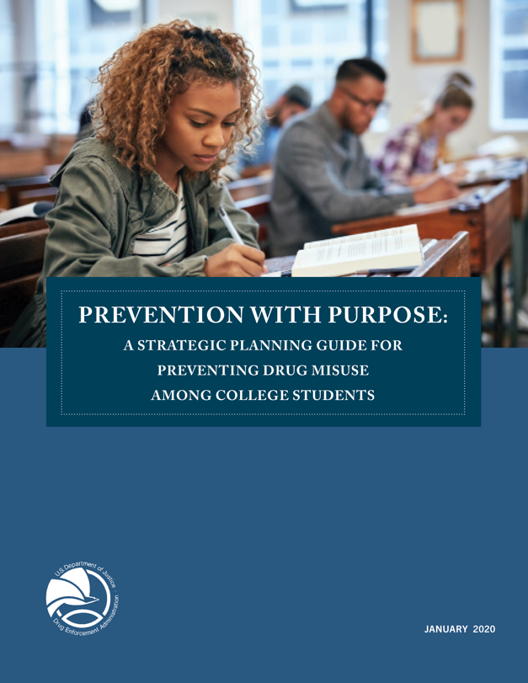
Strategic Planning Guide – Overview
Provides overview of the historical and current landscape of prevention
Designed to be useful for both new
and experienced higher education prevention professionals
Focuses explicitly on applying the SPF to college campuses
Notes:
Review the points on the slide. Emphasize that the guide is designed to be useful for both new and experienced higher education prevention professionals.
Let participants know that the guide:
Is available in print and online versions
Includes interactive worksheets
Identifies online resources for each chapter
Ask participants if they have any questions at this point.

Slide 10
What’s in the Strategic Planning Guide?
Notes:
Explain to participants that you will now briefly walk through each chapter to highlight what information is covered.

Slide 11
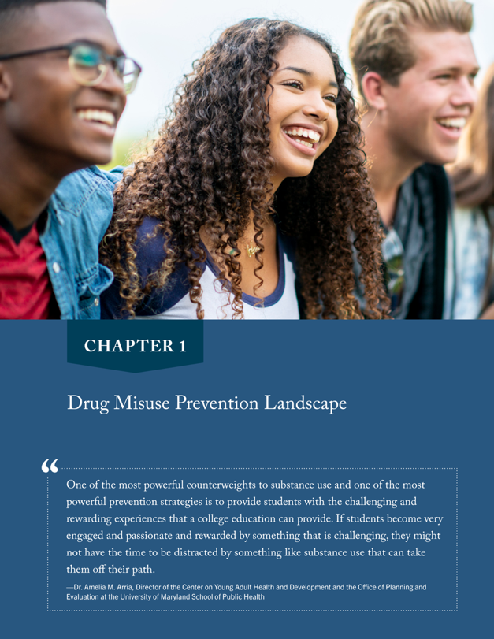
Drug Misuse Prevention Landscape
CHAPTER 1
Provides a “bird’s-eye view” of drug misuse prevention
Gives context for why drug misuse prevention is needed on college campuses
Notes:
Share with participants that the first chapter in the strategic planning guide provides readers with a “bird’s-eye view” of drug misuse prevention. It provides the context in which drug misuse prevention on college campuses is implemented.

Slide 12
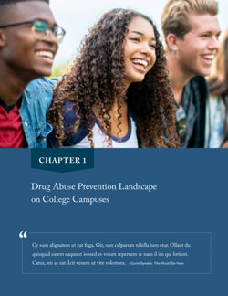
Chapter 1 includes…
History of Drug Legislation (1960s –Present)
Current Trends in Young Adult Drug Use
The Impact of Environment
Groups of Students at Higher Risk
Federal Policies that Affect Prevention on College Campuses
Notes:
Share that the sections included in Chapter 1 are listed on the slide. Then give some examples of the kind of information found in this chapter including:
The History of Drug Legislation section describes how history colors the current landscape we find ourselves in as health and wellness professionals on college campuses. This historical context can shed light on where resistance to our drug misuse prevention work comes from.
Groups of Students at Higher Risk section discusses information about how subgroups of students on college campuses may be at higher risk for drug misuse, including athletes, fraternity and sorority students, LGBTQIA+ students, and students with certain mental health conditions. This knowledge can help guide the focus of our prevention efforts on our campuses.
(Note: If other examples from this chapter are more applicable for your audience, use those instead.)

Slide 13
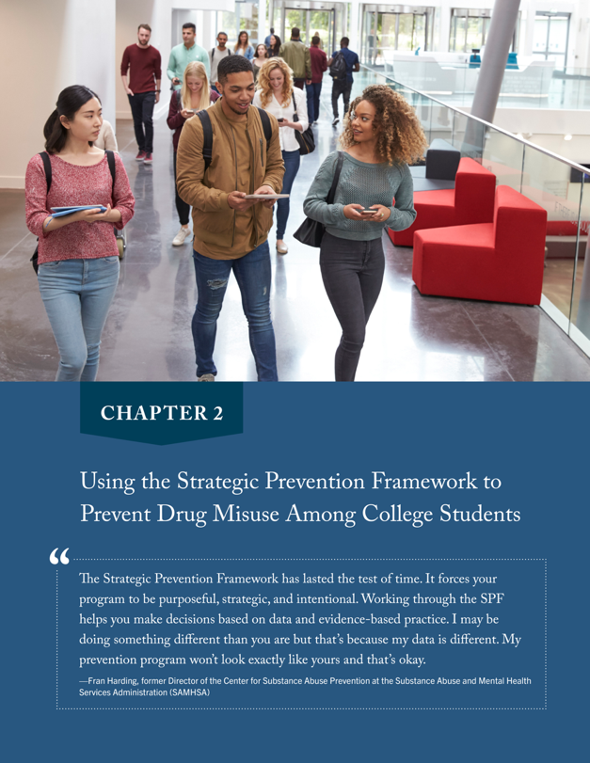
Using the SPF to Prevent Drug Misuse Among College Students
The SPF strengthens college drug misuse prevention programs by:
Creating a structure to be purposeful, strategic, and intentional
Helping you make decisions based on data and evidence-based practices
Notes:
Share with participants that Chapter 2 focuses on introducing the Strategic Prevention Framework (SPF) to readers.
Review the points made on the slide. Emphasize that it is crucial that we use data-driven processes as we design and implement our prevention efforts on college campuses. Just doing what “feels good” or what people like or enjoy will not result in the impact that you want and need on your campus.

Slide 14
The SPF Process Answers…
Notes:
Walk through the slide, highlighting the questions that the SPF process answers.
Ask participants to think about an activity in your everyday life or work that incorporates ALL of these questions. Provide participants with the following example, or one of your own examples:
What is the problem? My hot water heater is leaking
What do I have to work with? My friend who is a plumber, online resources to guide me to diagnosing the problem, new hot water heater from my local store
What should I do and how should I do it? Contact my friend to see if she is willing to help. Set up time to have her come to our house. Purchase hot water heater. Drain old hot water heater and remove it. Install the new hot water heater. Test new heater to see if it is working and if there are any leaks.
How can I put my plan into action? Schedule time for my friend to come. Ask spouse to also help at that time. Work as a team to uninstall old hot water heater and install new one.
Is my plan succeeding? Was the new hot water heater installed? Are there any leaks? After two hours, what is the hot water temperature?
If time is available, ask participants to find a partner and have them share with one another the activity they thought of and how that activity incorporates all of the questions on the slide. If limited time is available, simply ask one or two participants to share with the whole group the activity they came up with. Once they have shared, explain that these questions are answered by each of the five steps of the SPF: assessment, capacity, planning, implementation, and evaluation.

Slide 15
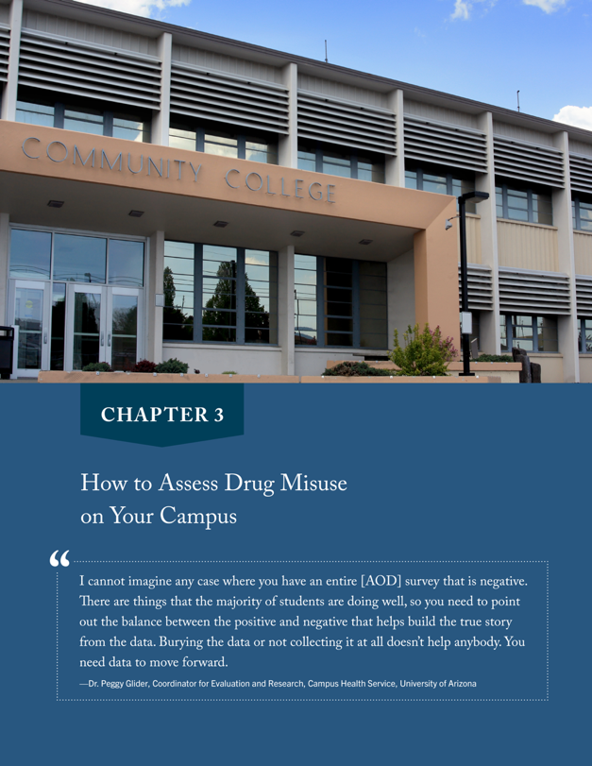
How to Assess Drug Misuse on Your Campus
CHAPTER 3
Implementation without completing an assessment is like building a home without an architect blueprint.
Notes:
Share the following with participants:
For those of you who work every day to protect the health and well-being of your campus’s students, highlighting the substance misuse of those students can often feel like yelling into a void. Part of this difficulty is built into the college environment. A college education prioritizes new experiences and asks students to challenge long-held beliefs, which can make it tempting to see drug experimentation or even regular drug use as exploratory rather than problematic.
One way to overcome this resistance is through the use of data, which has the added advantage of being incredibly valued on a typical college campus. Students are asked every day to substantiate their ideas with data and facts, and the professors and administrators whose support you need to move prevention programs forward respect and respond to the marshaling of empirical evidence.
How, though, do you begin the process of assessment? How do you quantify and define problem behaviors? This chapter walks prevention professionals through this process, which is the first step in the Strategic Prevention Framework (SPF) process.
Implementing a prevention program without completing and using the data from a needs assessment is like building a home without an architect designing the blueprints. How successful would the structure of your new home be without their input? It’s risky! The same goes for prevention: If you begin implementing a program without understanding the needs and environment of your college campus, you are at high risk for not having an impact on drug misuse on your campus.
It’s tempting to jump into implementation. You hear about a great program that another college is implementing, or you read a research study about an effective, evidence-based program, so why not try it? However, if you haven’t assessed what is happening on YOUR campus, then implementing a program is a shot in the dark as to whether or not it will be effective on your campus.

Slide 16
Chapter 3 includes…
STEP 4: Share your assessment findings
Who will be interested?
What format works best?
STEP 3: Assess capacity for prevention
What resources exist to support prevention?
How ready is my campus for prevention?
STEP 2: Assess risk and protective factors
Which risk and protective factors are prevalent on campus?
STEP 1: Assess problems and related behaviors
What? Where? How? Who?
Notes:
Share with participants that the Assessment portion of the SPF involves four steps, as outlined on the slide. The goal of the SPF assessment tasks is to put together a data-driven picture of what is happening on your campus including:
Amount of drug misuse on campus
What factors are placing students at greater risk of misusing drugs (risk factors), such as friends who use drugs
What factors are protecting students from the impact of risk factors (protective factors), such as strong parental bonding
The resources, or capacity, that exist on your campus to support you in implementing prevention efforts
How ready and willing your administrators, faculty, parents, and others are to commit to prevention efforts
This information is crucial to have before putting together a plan for prevention efforts on your campus.

Slide 17
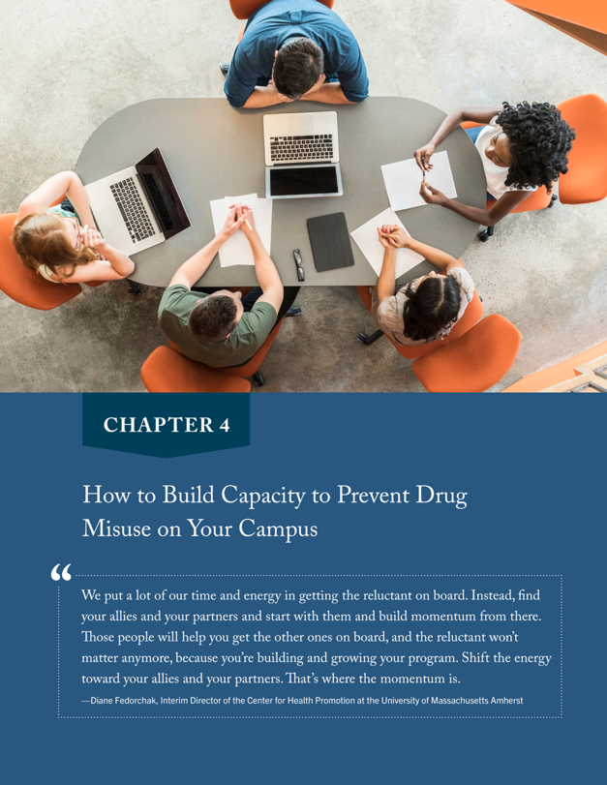
How to Build Capacity to Prevent Drug Misuse on Your Campus
CHAPTER 4
Having the capacity (both resources AND readiness) for prevention efforts is essential for success.
CAPACITY
=
+
RESOURCES
READINESS
Notes:
Share with participants:
If you’ve ever been at a higher education conference focused on alcohol and other drug misuse prevention, you likely will have seen a presentation that makes campus and community collaboration to address alcohol and other drug issues look easy. The presenter may run the university alcohol and other drug office, and may describe how she works with law enforcement, local landlords, alcohol retailers, and bar and restaurant owners to address alcohol and other drug misuse by college students. All of the parties seem to be on the same page and committed to building a healthy community for their college-age residents.
If you’re struggling to get your prevention program efforts off the ground, a presentation like this can feel frustrating and demoralizing. How do they do it? How are all their community partners committed to one goal rather than blaming one another for the problems caused by college students’ AOD consumption?
The answer is the difference in the capacity of a community or a campus to take action to address prevention priorities. Capacity is the combination of resources available for prevention efforts and the readiness of the community to take action to implement prevention efforts. The work to build capacity for your campus prevention program builds on what you have done in the assessment step when you determined what resources were in place on your campus and the level of readiness for prevention. This capacity building work is the focus of Chapter 4.
Be sure to mention the following key points about why assessing capacity comes before planning in the SPF process:
To make a realistic match between the problems identified and the resources available and/or needed to address the problems and their risk factors
To discover strengths and shortfalls in key resources, such as funding, people’s skills, people’s ability to work collaboratively
To provide an opportunity to address any shortfalls or gaps in resources in advance
To provide an understanding of how resources and readiness may influence the planning, selection, and adaptation of an intervention

Slide 18
Chapter 4 includes tips for…
STEP 3: Raise community awareness of the issue
Helps to garner valuable resources and increase campus readiness
STEP 2: Develop and strengthen a prevention team
Be strategic about why you want to bring each new partner on board
STEP 1: Engage diverse community stakeholders
Which groups of people do you need to connect with to ensure your prevention program will be successful?
Notes:
Share that the sections included in Chapter 4 are listed on the slide. By completing these tasks, higher education prevention professionals will increase their capacity to implement their prevention efforts, setting themselves and their students up for success.
Activity: Ask participants to find a partner and brainstorm campus and community sectors they may want to involve in their prevention initiative. (See page 40 of the strategic planning guide for ideas, if participants are needing help.) After about 2 minutes, ask for some ideas they generated.

Slide 19
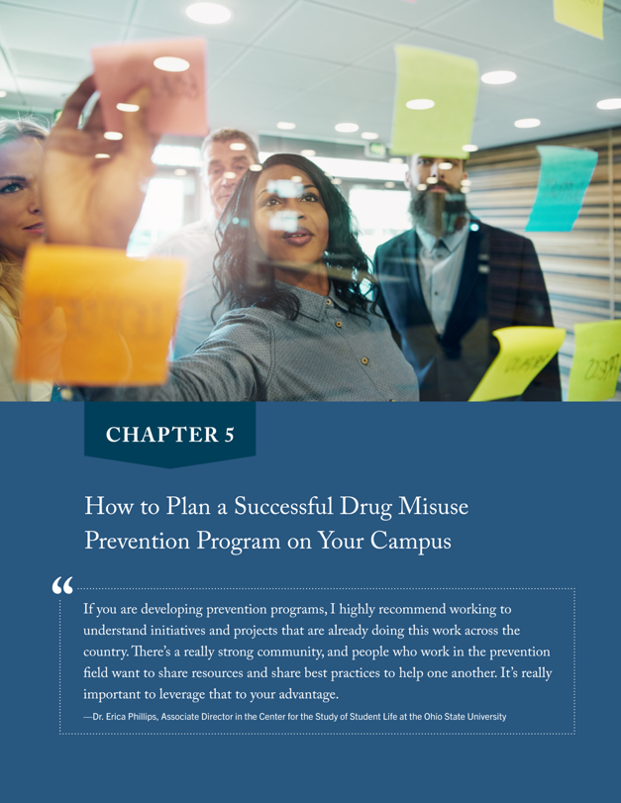
How to Plan a Successful Drug Misuse Prevention Program on Your Campus
CHAPTER 5
Caution! Think twice about the rotating cast of motivational speakers, online prevention programs, and in-person workshops on college campuses.
Craft a prevention plan that is uniquely tailored to your campus’s needs.
Notes:
Share with participants:
For those of you who have spent time working to prevent alcohol and other drug misuse on college campuses, you know that there is a rotating cast of motivational speakers, online prevention programs, and in-person workshop facilitators that seem to make the rounds from one campus to another. One year, social norms experts are all the rage in your AOD professional group, and the next, everyone is wondering if the new online motivational interviewing-based drug misuse prevention program will work for their first-year student orientation programming.
In many ways, we are fortunate to work among such committed and passionate prevention professionals, But having an excess of interesting and engaging prevention programs and workshops at our disposal can make the job of strategic prevention more difficult than it needs to be. How many of us have reached out for feedback to a professional group for a prevention program idea and ended up more uncertain than when we started?
The SPF can help eliminate that confusion. It is grounded in the idea that every prevention plan is unique and should be designed to meet the specific needs of the community. For those of you who work on college campuses, this means doing a deep dive into the distinctive characteristics of your students and their alcohol and other drug usage patterns, and then crafting a prevention plan that is uniquely tailored to address their needs.
Chapter 5 will walk you through crafting your plan.

Slide 20
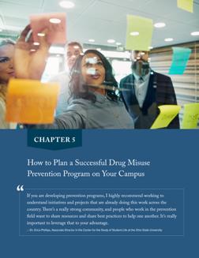
Chapter 5 includes…
Prioritize risk and protective factors
Importance and changeability
Select interventions to address priority factors
Evidence-based, conceptual fit, practical fit
Determine how many interventions you can implement
Widespread reach, multiple domains, cultural relevance
Build a logic model and share with stakeholders
Where you want to go and how you intend to get there
Notes:
Share that the sections included in Chapter 5 are listed on the slide and then point out the following:
No campus AOD misuse prevention program can address all of the risk and protective factors—at least not all at once. So this chapter includes information on how to figure out which risk and protective factors to address first on your campus.
Sometimes, prevention professionals may want to select interventions that are popular, that worked well on a different campus, or that they are familiar with. However, these are not great reasons for selecting an intervention. Consequently, criteria is included in this chapter to help higher education prevention professionals to identify which prevention efforts will be the best fit for their campus.

Slide 21
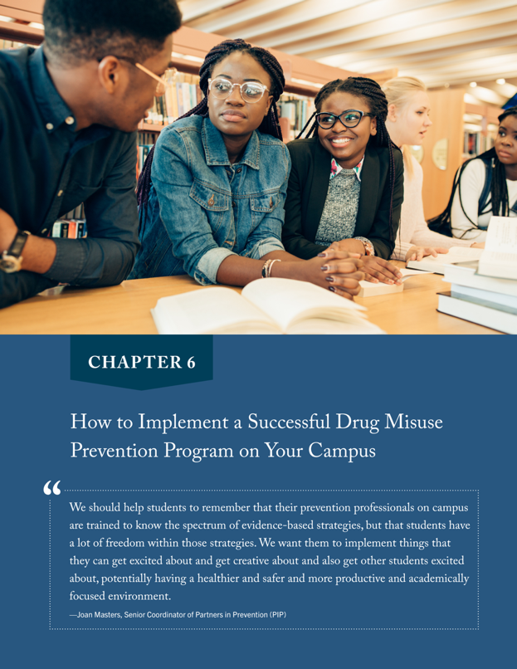
How to Implement a Successful Drug Misuse Prevention Program
CHAPTER 6
Before jumping into implementation, preparation is needed.
Notes:
Share with participants:
After completing the planning step of the SPF, it can be tempting to jump right in and start implementing. However, the success of a prevention effort depends on completing some tasks before implementation begins. Taking your time to complete these tasks is crucial to build support for your prevention program and to ensure that you reach your target student population.

Slide 22
Chapter 6 includes…
Connect with key implementation partners
Balance intervention fidelity and adaptation
Establish implementation supports
Communicate openly and make sure all partners are on board as you move forward
Fidelity: Maintain core components
Adaptation: Modify with care
Identify ways for people to get involved
Keep leaders well informed
Get the word out to broader community
Notes:
Share that the sections included in Chapter 6 are listed on the slide.
Ask participants: Have you ever seen a well-known, evidence-based prevention program implemented on a college campus that wasn’t well received by students? Or the students didn’t even show up or engage with the program?
Ask for an example or two from participants. Once you have heard from one or two participants, reinforce, as applicable, that information in Chapter 6 will help higher education prevention professionals to avoid some of the challenges mentioned.
ACTIVITY: Ask participants to draw a house on a piece of paper and then hold it up so everyone can see it. Then ask them to draw a house that is one story tall with two windows and a door on the front of a house and a chimney in the center of the roof. (Repeat the instructions as needed.) Then have them compare their pictures and discuss what they notice. Be sure the point is made that the drawings look much more similar the second time. Ask them why that was. Summarize by saying that when everyone followed a similar, detailed design, the pictures looked very similar. Ask participants how this is an analogy with implementing prevention programs? (When programs are implemented with fidelity, they produce similar outcomes. If you just implement a program however you want, you can’t expect the same outcomes.)

Slide 23
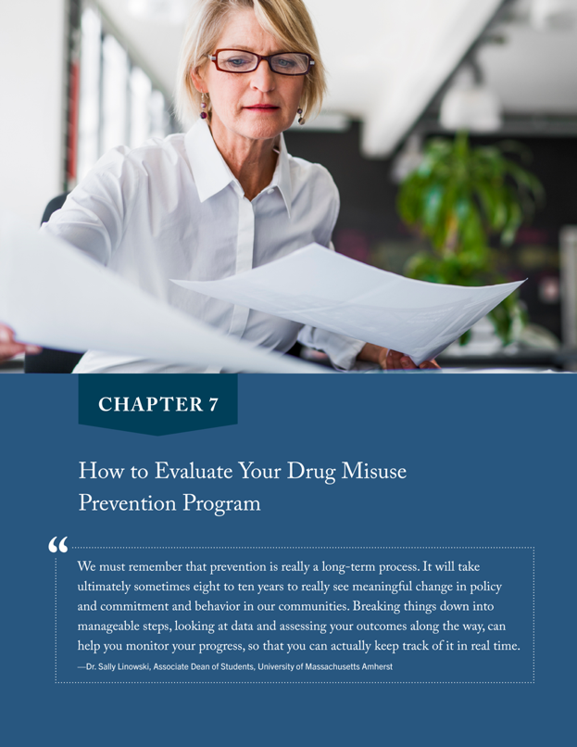
How to Evaluate Your Drug Misuse Prevention Program
CHAPTER 7
How will we know if our prevention efforts are working?
Notes:
Share with participants:
Without evaluation, how will we know our prevention efforts are working? It’s like trying to look across a lake on a foggy morning… we might be able to make out a few objects, but nothing is clear. Similarly, without strong evaluations, we can guess about our effectiveness, but won’t have actual answers.
How many of us enjoy prevention program evaluation? Working on a college campus where the focus is on furthering knowledge, using fact-based evidence, can make your work to change behaviors feel futile. How do you measure real behavior change? How do you account for shifts in AOD knowledge that don’t lead to behavior change? Why, despite all you are doing, do your students’ alcohol and drug use rates remain steady?
When faced with such daunting questions, you might instead focus on measures of engagement: How many students attended your workshop, or how many students went through your screening and brief intervention program.
However, a singular focus on engagement misses the real value of evaluation—rather than seeking to prove something, as many of the researchers on your campuses are working to do, evaluation seeks to improve processes. Understood in this way, evaluation is an exciting part of your prevention work as it can help you to enhance and tailor your programming to better ft your student populations.
Evaluation is the fifth step of the SPF, and it involves examining both the process and outcomes of prevention interventions. When conducting an evaluation, you want to systematically collect and analyze information about prevention activities to reduce uncertainty, improve effectiveness, and make decisions.

Slide 24
Chapter 7 includes…
Different types of evaluation
Process: Documents how prevention effort was implemented
Outcome: Measures impact of the prevention effort
Four basic evaluation principles
Utility, Feasibility, Propriety, Accuracy
Evaluation tasks
Six tasks in checklist format
Notes:
Share that the sections included in Chapter 7 are listed on the slide. Share that by working through the tasks in Chapter 7, higher education prevention professionals will have some tools to plan and implement both process and outcome evaluations for their prevention efforts.

Slide 25
Advice for Established and Emerging College Prevention Professionals
CHAPTER 8
Inside look at the lessons learned by a prevention professional with 30+ years of experience in college AOD misuse prevention
Recommendations for established professionals
Suggestions for new professionals
iStock.com/jpgfactory
Notes:
Share with participants:
In this final chapter of the guide, we provide an inside look at the lessons learned by a prevention professional, Dolores Cimini, who has 30+ years of experience addressing AOD misuse among college students. Advice is included for both established and new professionals.
For over 30 years, Dolores Cimini has been a mentor in the field of college AOD misuse prevention. Based at the University at Albany, one of the university centers of the 64-campus State University of New York (SUNY) system, Cimini has spent her career working directly with students. She has produced numerous peer-reviewed public health studies and is the co-editor of Promoting Behavioral Health and Reducing Risk Among College Students: A Comprehensive Approach (2018). Cimini currently runs the award-winning Middle Earth Peer Assistance Program at the University at Albany and is the director of the Center for Behavioral Health Promotion and Applied Research.
Cimini’s hard-earned advice is offered in this chapter.

Slide 26
Closing Thoughts
Notes:
Share with participants these closing thoughts:
This guide is intended to provide a road map for experienced and new higher education prevention professionals to collaborate with a wide range of stakeholders to address campus-wide drug misuse issues.
Ask participants if they have any questions about what you have presented.

Slide 27
FOR MORE INFORMATION:
DEA Campus Drug Prevention website www.campusdrugprevention.gov
Prevention with Purpose: A Strategic Planning Guide for Preventing Drug Misuse among College Students
www.campusdrugprevention.gov/preventionguide
Notes:
Share that there is a wealth of information on the DEA Campus Drug Prevention website.

